Slide 1
Secure data hiding in images using Steganography
CAPSTONE PROJECT
Presented By: M VAMSHI KRISHNA REDDY
Student Name : M VAMSHI KRISHNA REDDY
College Name & Department : M S Ramaiah University of Applied Sciences in Bengaluru, Karnataka

Slide 2
OUTLINE
Problem Statement
Technology used
Wow factor
End users
Result
Conclusion
Git-hub Link
Future scope

Slide 3
Problem Statement
Data Security in the Digital World
Data security is a critical concern, especially when transmitting sensitive information. Traditional encryption methods can be complex and often require external storage for encrypted files.
This project introduces an image-based encryption and decryption system that allows users to securely hide secret messages within images. The decryption process is password-protected, ensuring that only authorized users can access the hidden information.
Challenges Addressed
🔹 Difficulty in securely sharing text messages. 🔹 Risk of data exposure in plaintext format. 🔹 Lack of simple encryption tools for non-technical users.

Slide 4
Technology used
Programming Language
🟢 Python – Used to implement the encryption and decryption logic.
Libraries & Frameworks
🔹 OpenCV – Handles image processing and manipulation. 🔹 NumPy – Supports array-based operations for embedding messages. 🔹 PyQt6 – Provides a user-friendly GUI for encryption and decryption.
Platforms
✅ Compatible with Windows, Linux, and macOS (requires Python installation).

Slide 5
Wow factors
What Makes This Project Unique?
Steganography-Based Encryption – Unlike traditional encryption, messages are embedded within the pixel values of an image, making them nearly invisible to detection.
User-Friendly GUI – No need for complex command-line operations; the intuitive interface simplifies encryption and decryption for all users.
Password Protection – The hidden message can only be decrypted with the correct password, adding an extra layer of security.
No Additional Storage Required – The message is stored directly inside the image, eliminating the need for separate encrypted files.

Slide 6
End users
Who Can Benefit from This Project?
Cybersecurity Enthusiasts – Explore advanced steganography techniques for secure communication.
Journalists & Activists – Safely share confidential information without detection.
Students & Researchers – Gain hands-on experience with cryptography and image processing.
Photographers & Designers – Embed copyright information within images for protection.
General Users – Securely hide private messages or sensitive data within images.

Slide 7
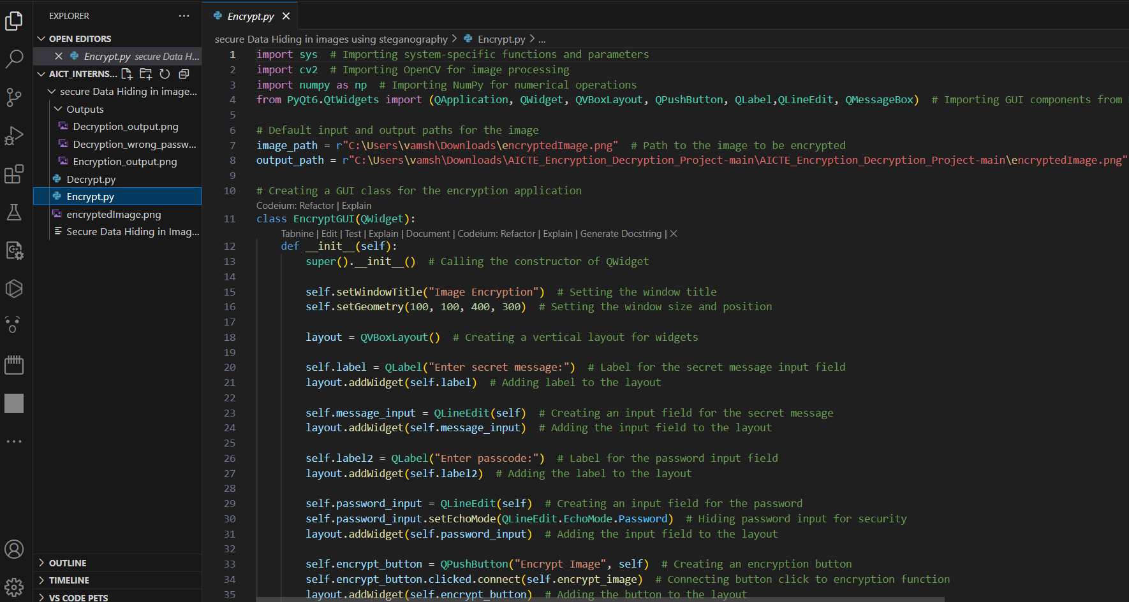
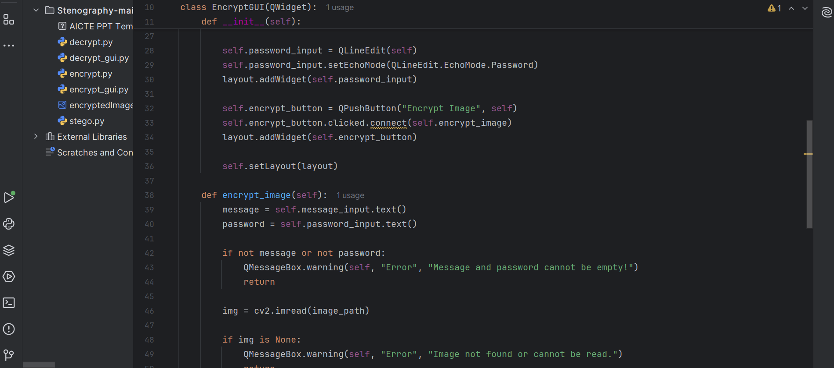
Results
Figure 1: Encryption Code

Slide 8
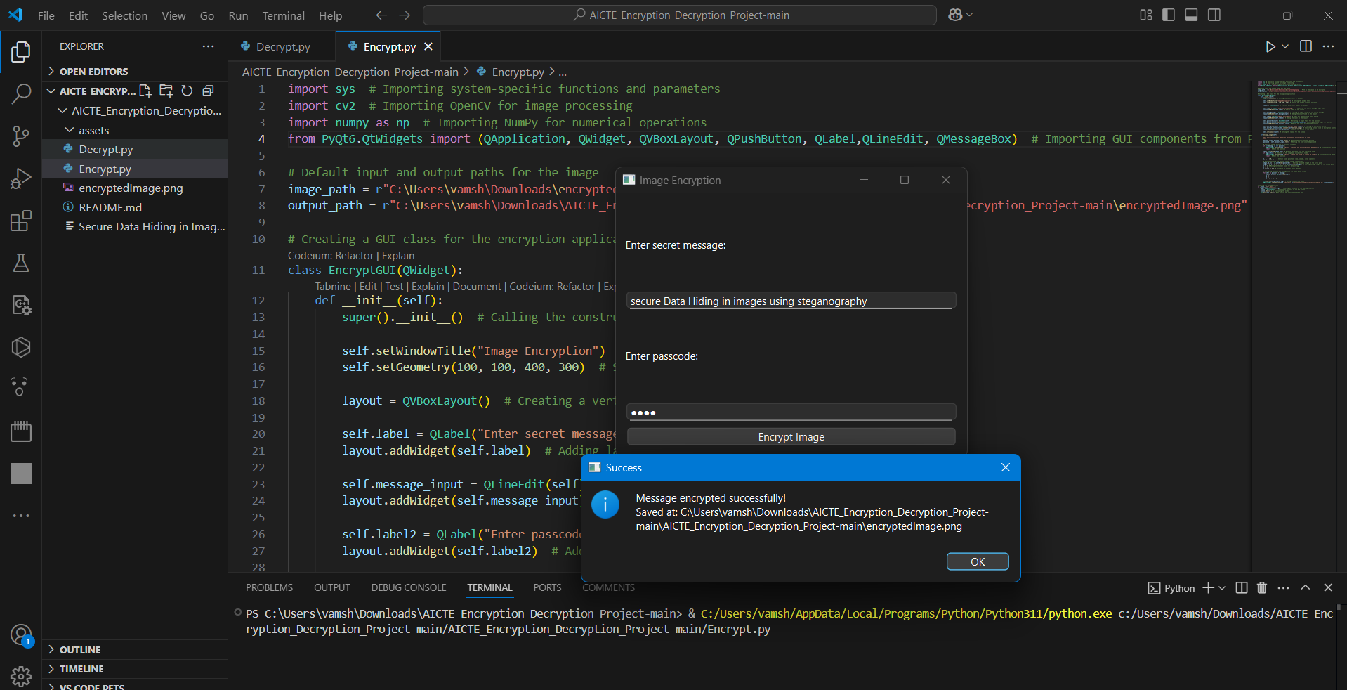
Figure 2: Encryption Output

Slide 9
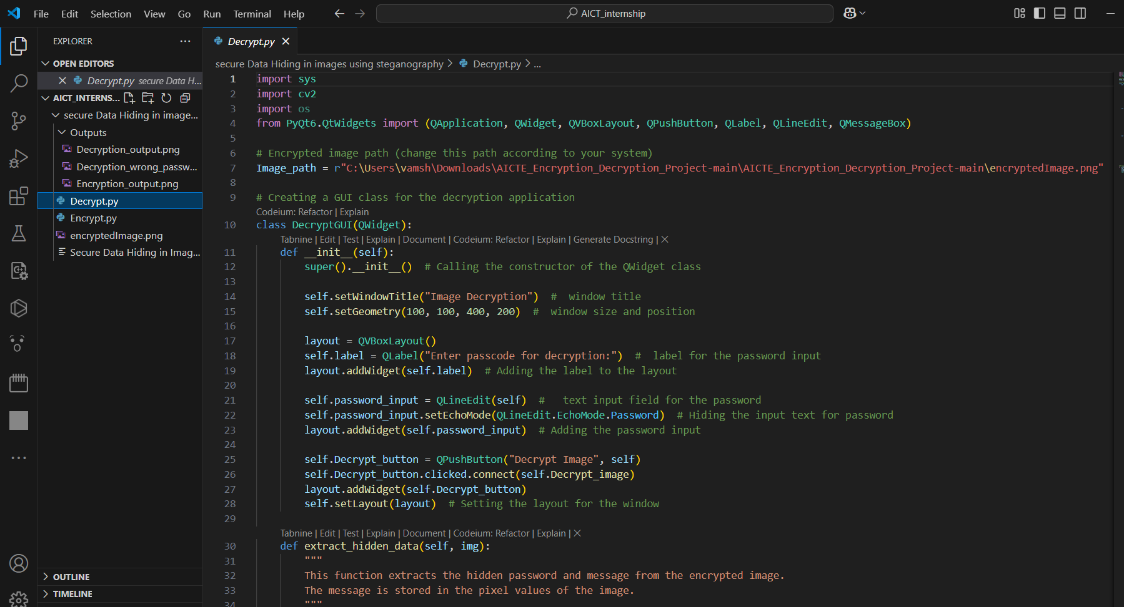
Figure 3: Decryption code

Slide 10
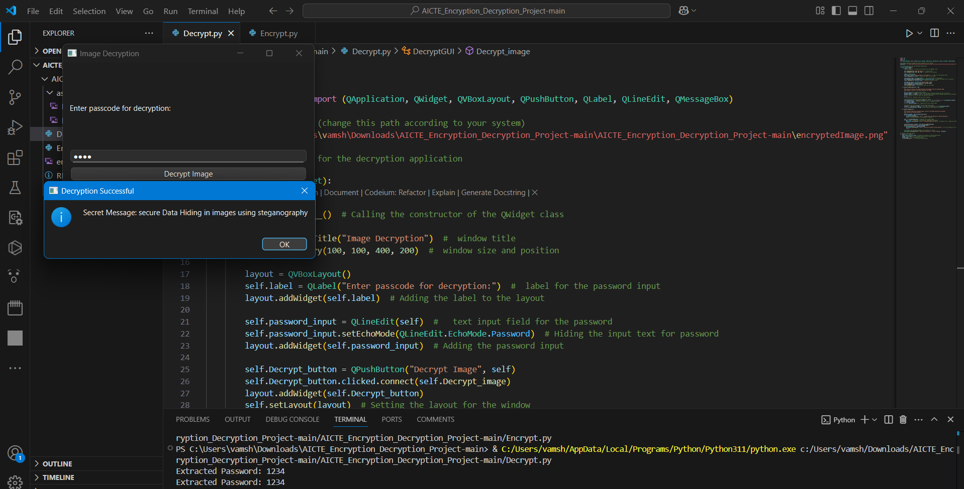
Figure 4: Decryption Output

Slide 11

Figure 5 : Encrypted Image

Slide 12
Conclusion
This project offers a simple yet powerful solution for securely encrypting messages within images using steganography and password protection.
By integrating a graphical user interface (GUI), the system becomes accessible to both technical and non-technical users.
Leveraging OpenCV and NumPy, the project ensures fast and efficient message embedding and extraction with minimal image distortion.
Overall, this project successfully demonstrates a practical application of image-based cryptography, enhancing secure communication.

Slide 13
GitHub Link
BibiAmina7/AICTE_Encryption_Decryption_Project

Slide 14
Future scope(optional)
Enhanced Security – Integrate AES or RSA encryption alongside steganography for a dual-layer security approach.
Support for Multiple Image Formats – Extend compatibility beyond PNG to formats like JPG, BMP, and TIFF.
Mobile & Web Integration – Develop a mobile app or web-based version for broader accessibility.
AI-Powered Image Security – Implement deep learning techniques for tamper detection and enhanced security.

Slide 15
THANK YOU

